Slide 1

VIDEO GAMES SALES ANALYSIS
Group 4
Boli, Hemanshi, Kanupriya and Surabhi

Slide 2
Agenda
Agenda
Project Introduction
2. Dataset Introduction
Introduction of targeting industry
Defining Problem
Solution
Number and description of data files
Number of columns and rows in each file
4. Descriptive Analysis
3. Data Processing
Correlation test
Best performed region of video game sales
top 5 Genre in terms of video game Sales
Selecting relevant columns
Merging data
Removing duplicate observations
Handling missing data
Handling outliers
5. Dashboard
PowerBI dashboard

Slide 3
Introduction
Our targeted industry is the Video games Industry.
Video game sector is immensely large and is growing fastly.
In 2021, the gaming industry generated total revenue of $178.73 Billions
Tech giants like Google, Apple have made plans to enter the industry
Subscription streaming services are the future and will be beneficial to video game companies
Notes:
Video games are a billion-dollar business and have been for many years. The vast growth of gaming industries attracts many companies.
However, lack of knowledge about the games trend and design make it difficult for companies to understand the demand of customers and therefore restrict them to enter the video game industry.

Slide 4

Problem
Although the video game industry does not get much attention, it is a billion-dollar business and has been for many years.
There is a lack of knowledge about the games trend and design. It is difficult for companies to understand the demand of customers that:
restrict them to enter the video game industry
restrict them to grow their business
Notes:
Video games are a billion-dollar business and have been for many years. The vast growth of gaming industries attracts many companies.
However, lack of knowledge about the games trend and design make it difficult for companies to understand the demand of customers and therefore restrict them to enter the video game industry.

Slide 5

Solution
Solution
To track trends and diagnose problems to find solutions for:
understand the demand of the customers
improving both sales and customer satisfaction
addressing the plans for improving the next version of the game
we analyze the video games sales dataset, which will be beneficial in improving both sales and customer satisfaction.

Slide 6
Data Overview
Data Overview
Datasets | Description | Number of Rows | Number of Columns
PS_Sales | Different generations of games Sales | 1196 | 9 columns: Name’, 'Year’, 'Genre’, ‘Publisher’, ‘north America Sales’, ‘Europe Sales’, ‘Japan Sales’, 'Other Areas Sales’, 'Global Sales'
PS2_Sales |  | 2161
PS3_Sales |  | 1329
PS4_Sales |  | 336
XOne_Sales |  | 213
X360_Sales |  | 1265
Country_Sales | Sales of different Platform games in 3 different regions | 10098 | 10 columns: ‘Rank’ above 9 columns
Global_Sales | Sales of different Platform games worldwide | 10098

Slide 7
Data Preparation
Data Preparation
Rename Columns
Delete Columns
Add New Columns
Reordering Columns
Merging Dataframes
To make consistency among columns’ names
Column ‘Rank’ in Global_Sales
Column ‘Platform’ added in 6 files representing data for 6 different platforms
Columns were reordered for having consistency
8 dataframes were merged to obtain 16600 rows and 10 columns
Notes:
Before merging the datasets, we need to make the name of columns similar for each dataset. So, first we check the columns name.
3 csv files have different names assigned to the same variables, our first step is to rename the columns.
As we can observe that to merge Countries_Sales and Global_Sales, there is one column named "Rank", specifying the rank of games based on global sales, is not required. So, the column "Rank" is deleted from the datframe.
We need to add column named "Platform" in the 6 datafiles describing sales of PS, PS2, PS3, PS4, X360 and XOne.
we merge 7 csv files and delete duplicate oberservations

Slide 8
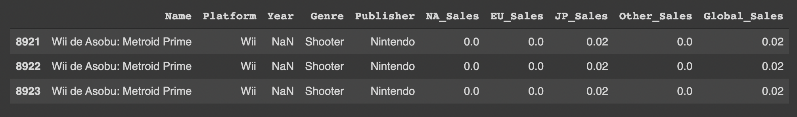
Data Preparation
Data Cleaning
Checking Duplicates- Getting final dataset
On removing the 3 duplicate values, the number of observations left were 16597

Slide 9
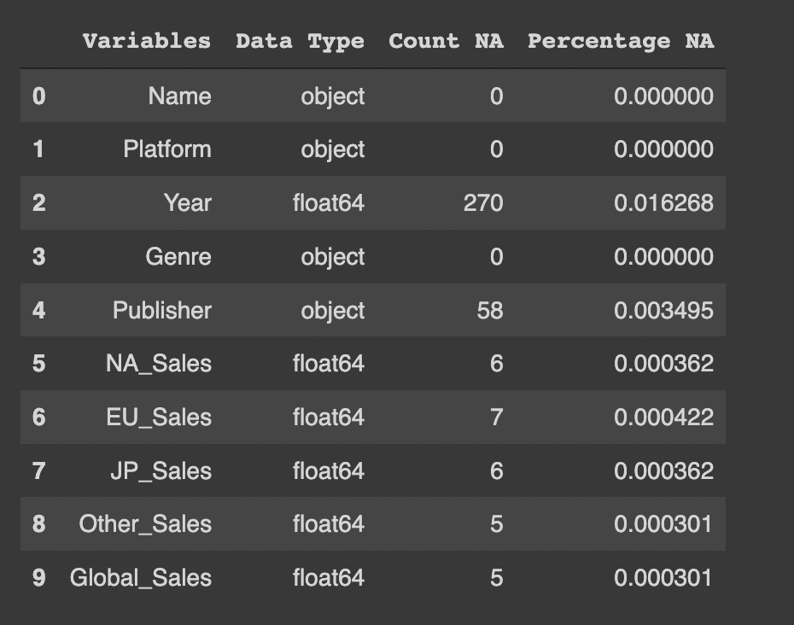
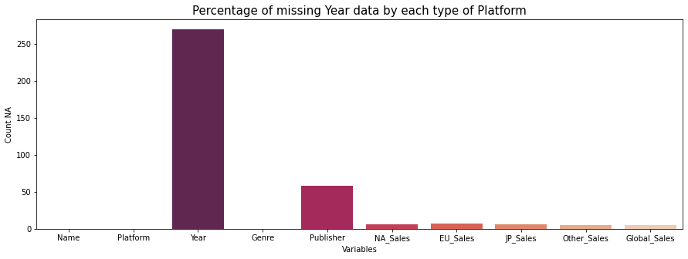
Data Cleaning
Data Cleaning
Checking Missing Data
Notes:
We will first create a table to know about the missing data in each column:

Slide 10
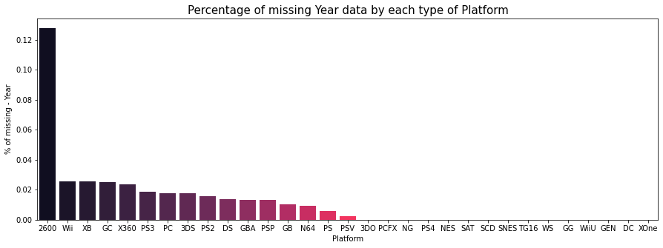
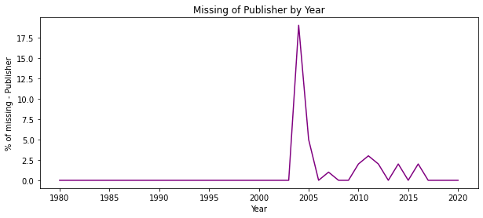
Data Cleaning
Data Cleaning
Missing Data By Each Variable - Missing By Random or not Random
More than 0.12% of Year data was missed for the Publisher named “2600”
More than 17.5% of Publishers data was missed in year 2004
Missing Data: Missing Not at Random
Notes:
So, column "Name" is the primary key as all its values are unique. Also, it can be observed that among 39 platforms, only 8 platforms (PS2, DS, PS3, Wii, X360, PSP, PS, PC) are un-rare and their proportion is 70% and among all the years only 8 years (2007, 2009, 2008, 2010, 2011, 2006, 2005, 2002) are unrare. It means that most of the data observations densely concentrate on these few labels (8 for Platform and 8 for Year).

Slide 11

Data Cleaning
Data Cleaning
Handling Missing Data
Dropping rows where Publishers were missing
Missing data for Year was imputed with Median
Data missing in Sales columns were imputed using the formula:
Global Sales = Sales in (North America + Japan + Europe + Rest of the World)
After removing missing data, number of observations - 16539
0.35% of missing data was removed

Slide 12
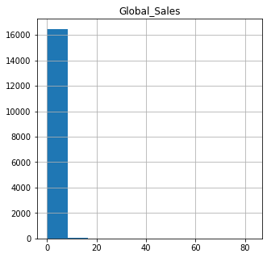
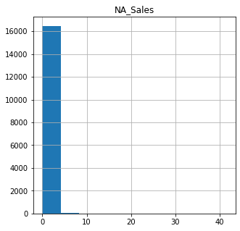
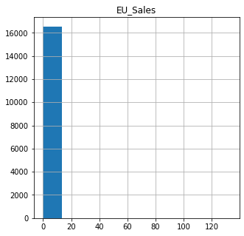
Distributions of Sales
Distribution of Sales
Notes:
We created histograms of North America sales, Europe Sales, Japan sales, other sales and global sales value grouped by Genre to detect outliers and distributions.
x axis is the sales values(in millions), y axis is the counts
The result of the histogram shows that the sales of each region and global sales are highly right skewed. We realised that most of the small companies contribute very less to sales. However, few big companies contribute largely to sales.
Thus, we decided to separate our dataset based on small and big companies and plot them separately.

Slide 13
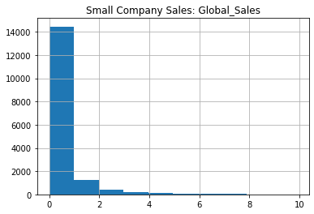
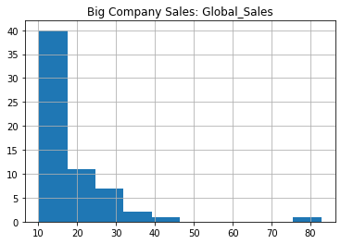
Sales Distribution for Big and Small Companies
Notes:
We set cutoff as 10 million dollars, when the sales are less than 10, we regard them as small companies. if the sales are equal or more than 10, we regard them as big companies.
the distribution is still highly right skewed, but we can get more information this way
around 14000 companies have sales lower than 1 million. around 40 companies’s sales is 10 millions, 10 companies’ sales is around 20 millions, 7 companies’ sales are around 30 millions,1 company’s sales is around 80 millions（which is the outlier）

Slide 14
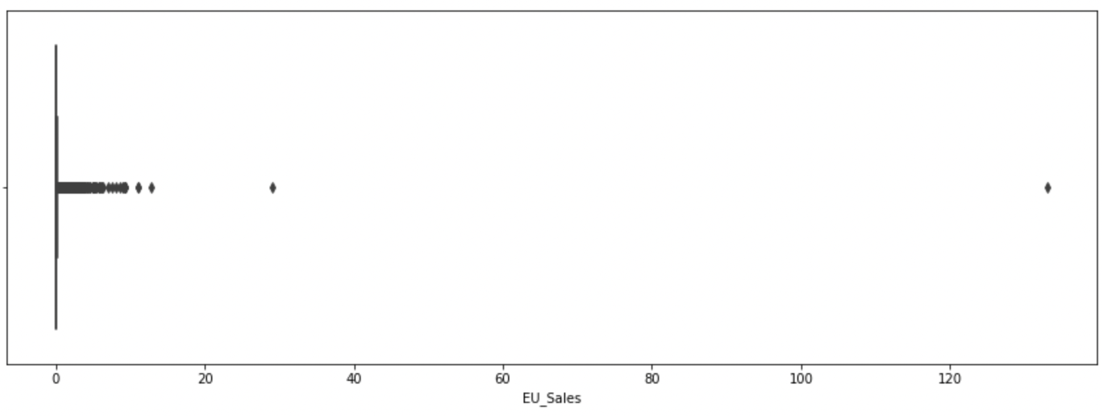
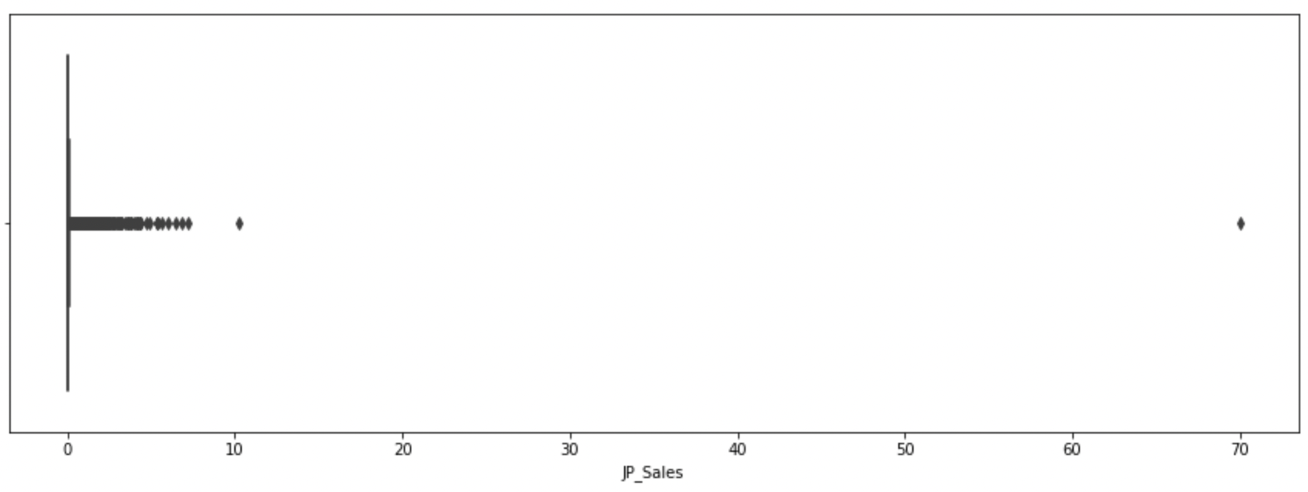
Outliers in Numerical Variables
(Box Plots)
Two outliers were detected in columns ‘Sales in Europe’ and ‘Sales in Japan’
So, we analysed and deleted the two rows having outliers and remained with 16537 observations

Slide 15
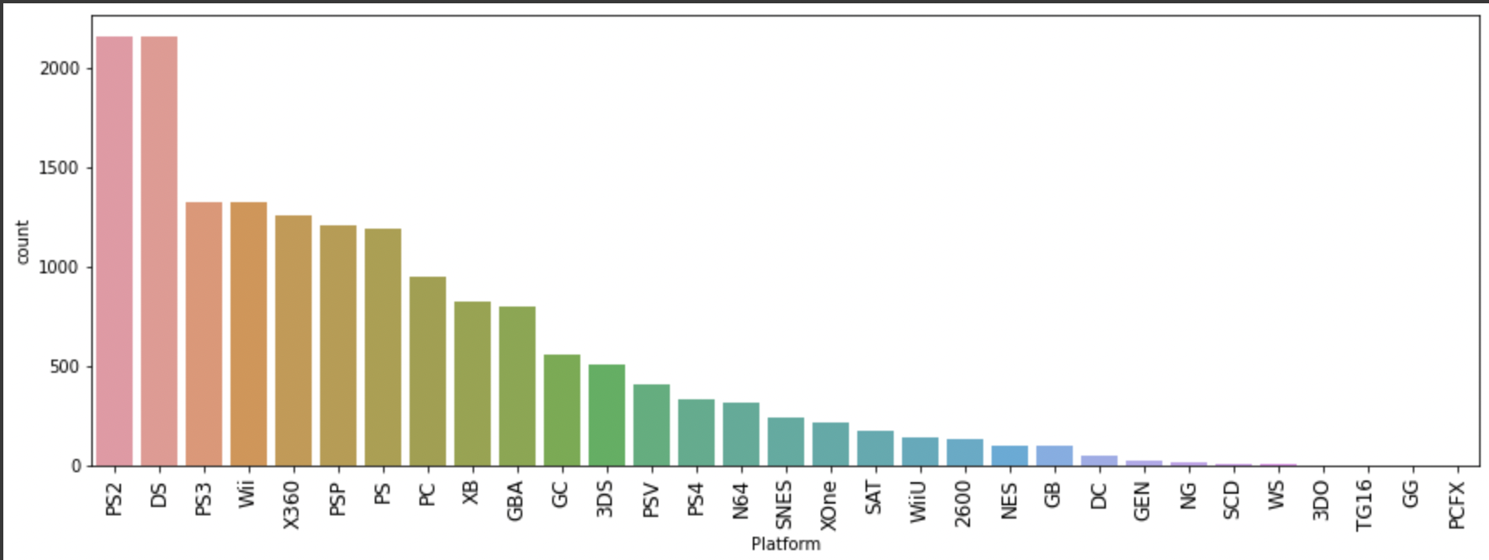
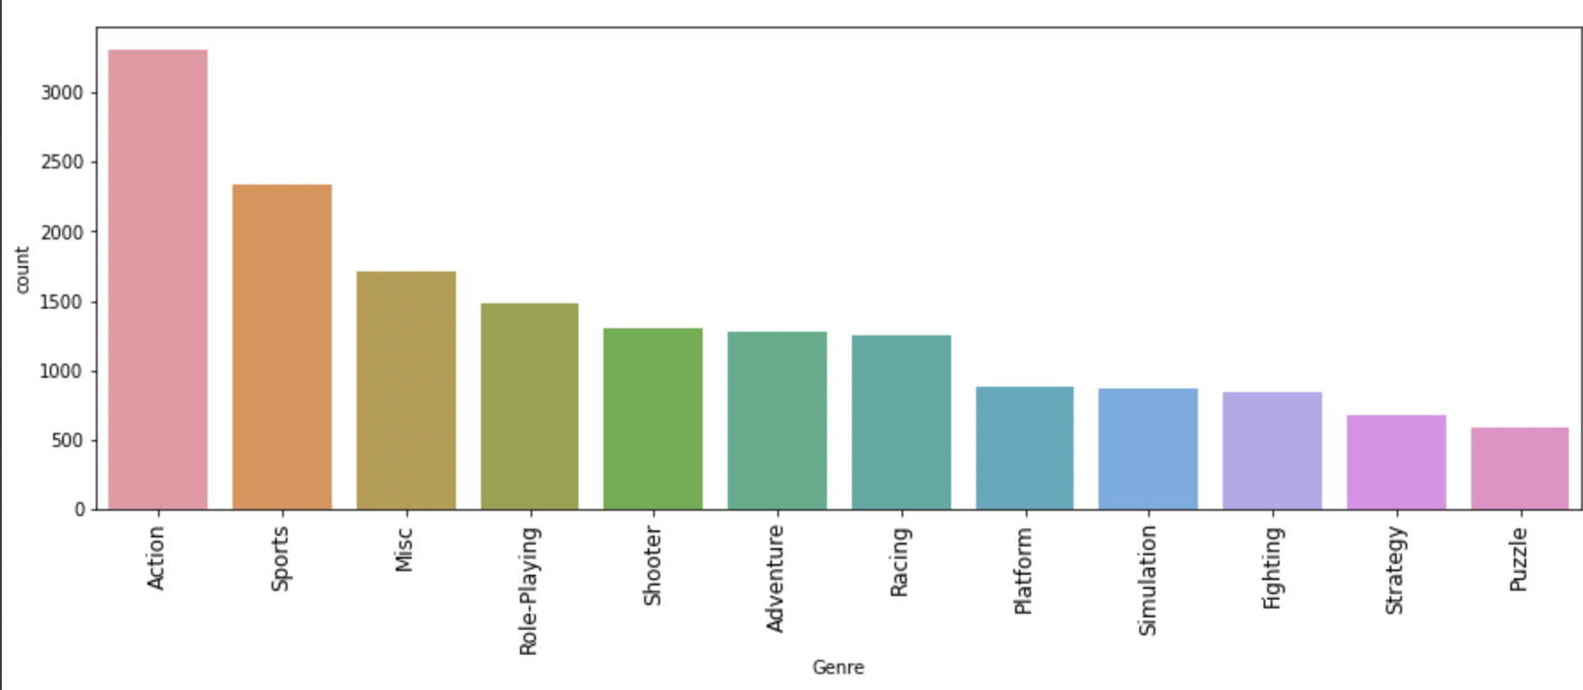
Outliers in Categorical variables
(Bar Graphs)
Outliers in Categorical variables
(Bar Graphs)
There was no out of range or inaccurate value in categorical variables.
Notes:
PS2 and DS game consoles have the highest amount of sales in all the platforms of video games
Action video game have the highest amount of sales in all the genres of video games

Slide 16
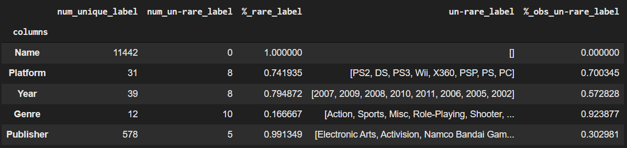
Unique and Rare Label Inspection
Unique and Rare Label Inspection
Primary Key: Name
8 platforms are ‘not unique’ and contribute 70% to the overall proportion
39 unique values for Year. 57% of the data is concentrated on 8 ‘non-unique’ values of Year
Notes:
So, column "Name" is the primary key as all its values are unique. Also, it can be observed that among 39 platforms, only 8 platforms (PS2, DS, PS3, Wii, X360, PSP, PS, PC) are un-rare and their proportion is 70% and among all the years only 8 years (2007, 2009, 2008, 2010, 2011, 2006, 2005, 2002) are unrare. It means that most of the data observations densely concentrate on these few labels (8 for Platform and 8 for Year).

Slide 17
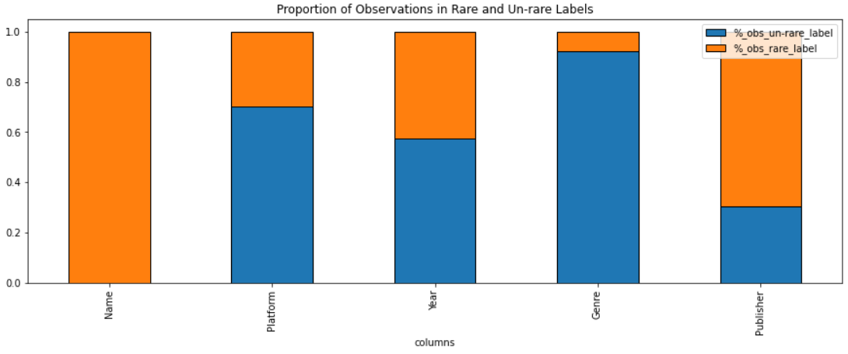
Unique and Rare Label Inspection
Unique and Rare Label Inspection
Notes:
So, column "Name" is the primary key as all its values are unique. Also, it can be observed that among 39 platforms, only 8 platforms (PS2, DS, PS3, Wii, X360, PSP, PS, PC) are un-rare and their proportion is 70% and among all the years only 8 years (2007, 2009, 2008, 2010, 2011, 2006, 2005, 2002) are unrare. It means that most of the data observations densely concentrate on these few labels (8 for Platform and 8 for Year).

Slide 18
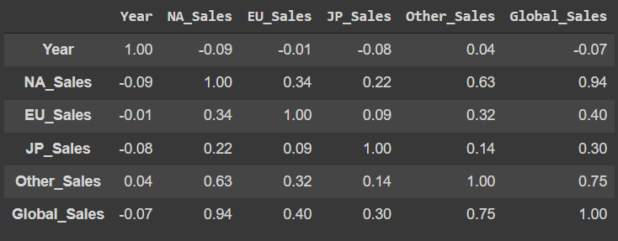
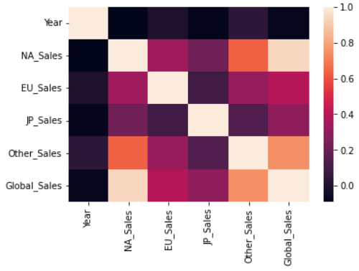
Correlation
Correlation
For Numerical variables
NA Sales and Global Sales are highly correlated (0.94), indicating that North America sales contributes the most in Global Sales.
Notes:
Now, we will look for the correlation between the variables to quantify the association between them or features of the dataset. For this, we first created a numeric dataframe and used it to further check for the association.
Once the correlation matrix is defined, it can be passed to Seaborn’s heatmap() method to create a heatmap (or headgrid). The basic idea of heatmaps is that they replace numbers with colors of varying shades, as indicated by the scale on the right. Cells that are lighter have higher values of r. This type of visualization can make it much easier to spot linear relationships between variables than a table of numbers.

Slide 19
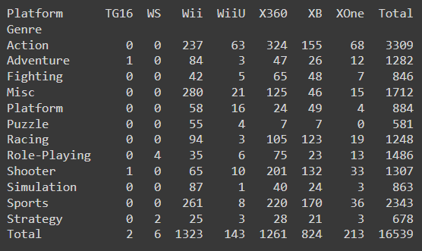
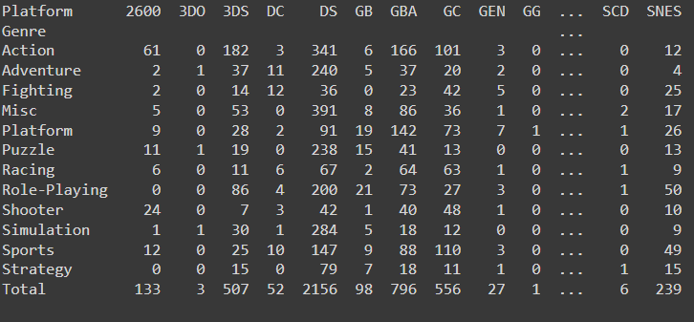
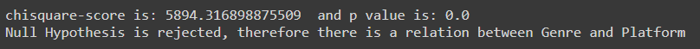
Correlation
Correlation
For Categorical variables - Genre and Platform
Performed Chi square test for dependency
p-value < 0.05
Platform and Genre are associated
Notes:
To check for the correlation for categorical variables, chi square test for dependency was performed.
Based on the results, p-value < 0.05 => reject H0 of independence.
there seems to be some dependency between platform and genre

Slide 20
General Questions Answered in Python
Notes:
To check for the correlation for categorical variables, chi square test for dependency was performed.
Based on the results, p-value < 0.05 => reject H0 of independence.
there seems to be some dependency between platform and genre

Slide 21
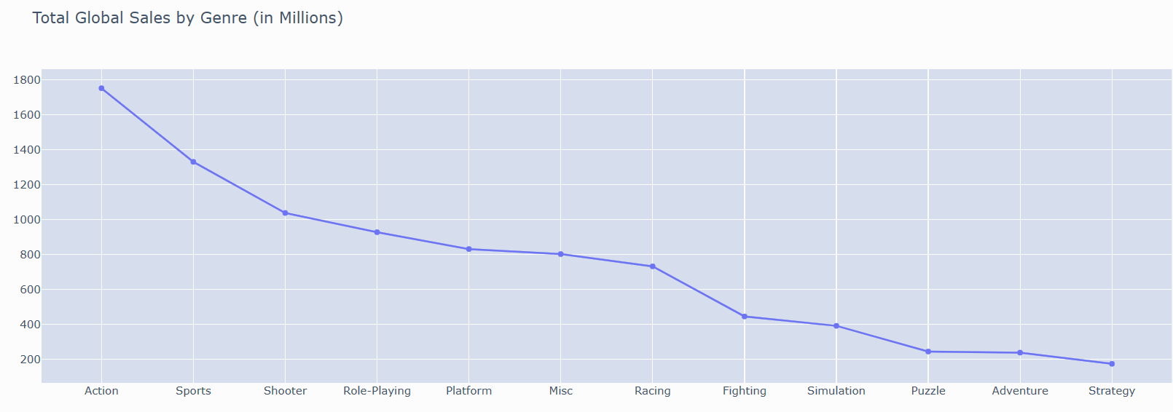
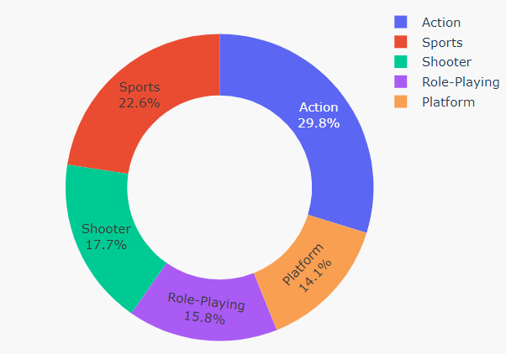
What are the top 5 Genre in terms of Sales?
Notes:
From the above line graph, we can observe that Action, Sports, Shooter, Role-Playing and Platform are the top 5 genres with maximum global sales.

Slide 22
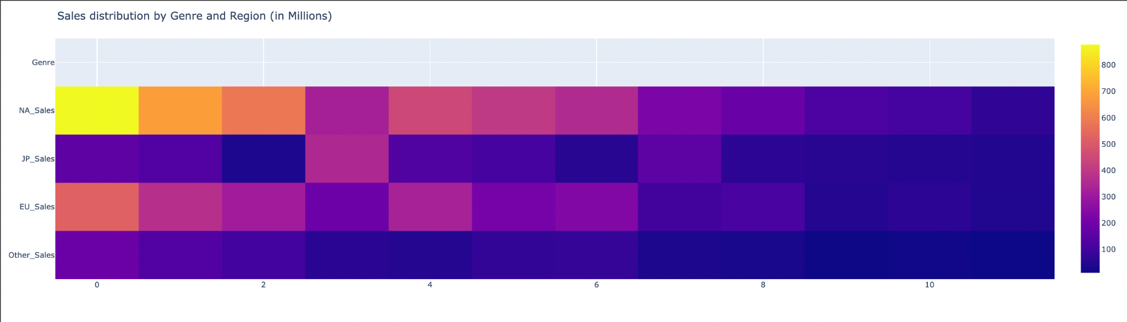
What are the top Genre in terms of Global Sales in different Regions?

Slide 23
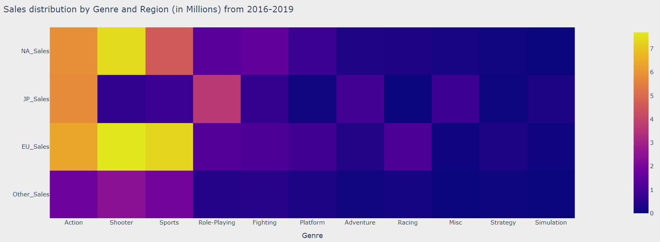
Did the interest of people about the genre changed with time?

Slide 24

Questions To Answer
More Questions To Answer
For analysing the trends of the sales and helping the newcomers to establish their place in this industry, the following questions are answered using our visualization app:
Which region has the most sales?
Which year was the golden year for each region when the sales was maximum?
What are the 5 top Genre in terms of Global Sales?
Was the most popular genre same in all regions?
What were the most popular games in top Genres?
What are the top 5 platforms?
Is there any difference among the sales for the top platforms in video games loving regions?
What are the top publishers?
Which Publishers shine in top Genres?
What are the least popular Publishers, Platforms and Genres?

Slide 25

FINAL DATA PRODUCT
https://app.powerbi.com/links/2yWsc4rWkN?ctid=707c861d-6374-4af3-b74e-404192474f68&pbi_source=linkShare&bookmarkGuid=4f4def35-2273-4608-a818-cb20e

Slide 26

CONCLUSION AND RECOMMENDATION
To start a business in video gaming industry, one should target the video game loveable regions like North America and Europe
Playstations are one the most popular platforms, so similar gaming platforms should be developed
More focus should be given on Action and Sports games
For the organization who are already in this industry, the most popular publishers like Nintendo, Electronic Arts and Sony Entertainment, should focus more on developing action games
The analysis are useful for newcomers and established companies to improve their sales and customers’ satisfaction.

Slide 27
THANK YOU

